Slide 1



Internet
&
programming
Mobile
CEF:440
supervisor:
DR. Valery

Slide 2

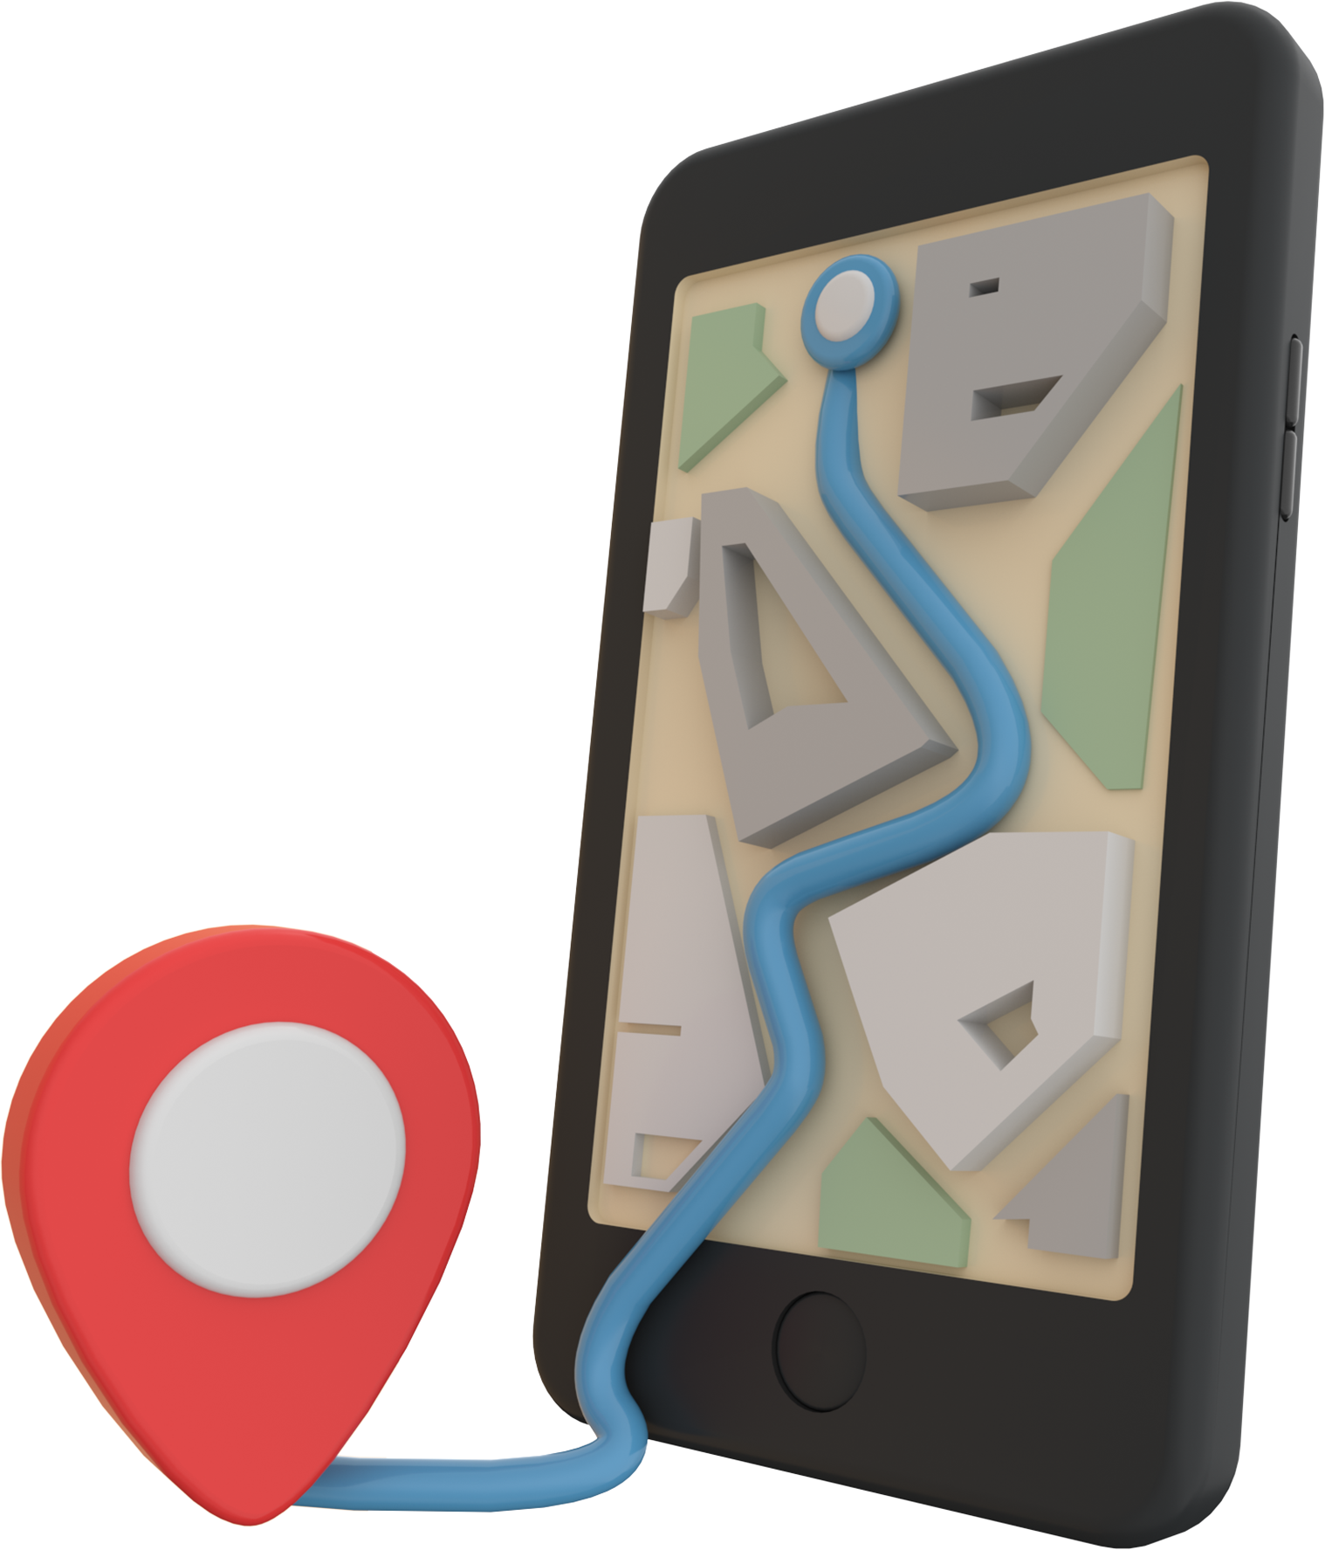
Design and Implementation of a Passenger Positioning System

Slide 3







System Requirements
Business and
user Requirements:
Design requirements:
Use Case diagram
Legal and Compliance Requirement
Technical requirements
Conclusions and Asumptions

Slide 4



Business and user Requirements
Performance And Reliability
Scalability And Flexibility Cost-Effectiveness
Passenger Safety And Security Emergency Response Capabilities Fuel management

Slide 5



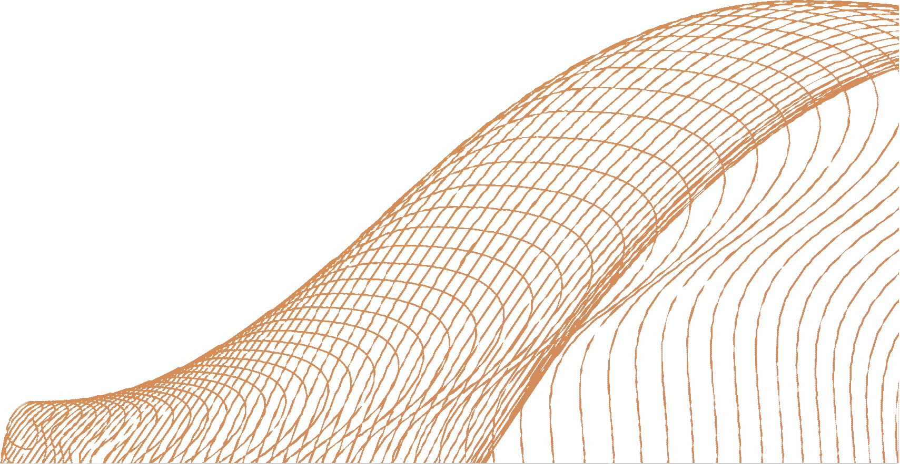


System Requirements
Real-Time Updates
Multi-Platform Support Personalization
Easy-To-Use Interface Mobile Accessibility Feedback And Ratings

Slide 6




Function And Non-Functional Requirements
functional requirements
Location tracking
Real-time updates ETA calculation Analytics and Reporting Push notifications
Non-functional requirements
Performance
Accessibility
Maintainability
Security
Data management

Slide 7

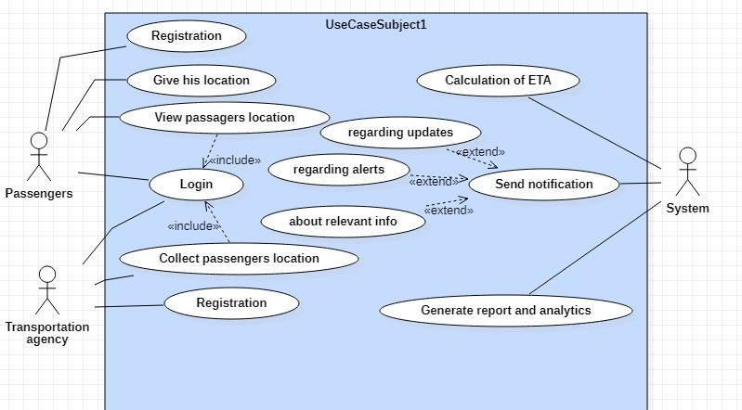

Use Case diagram

Slide 8



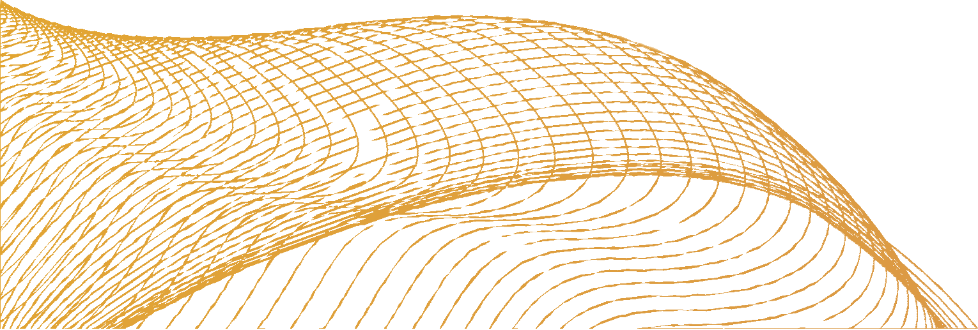
Technical requirements
Location-based services
API development Cloud infrastructure
Mapping and routing software API Real-time data processing
Mobile application development

Slide 9

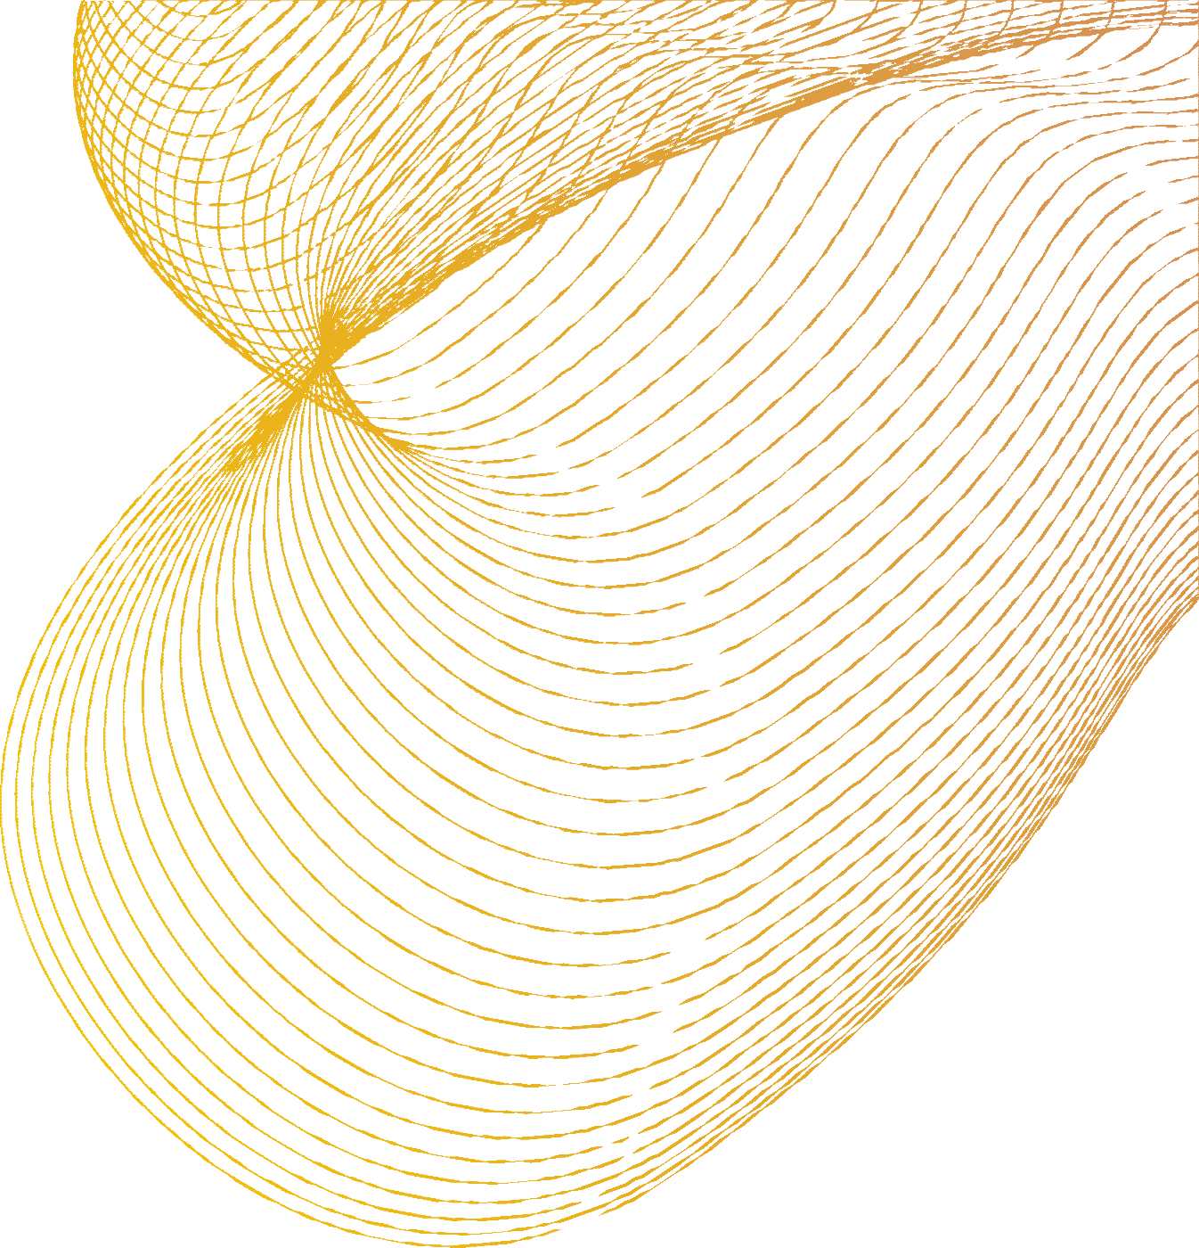



Integrated Technologies
Mapping APIs
Global Positioning
WiFi and Bluetooth
Cloud services
Mobile networks

Slide 10
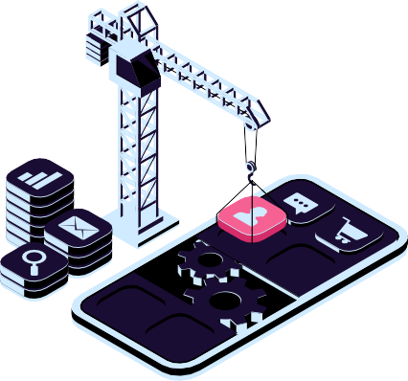
System Analysis
Problem statement
Architecture
Data flow diagram
Testing and Quality
Technical stack
Method of validation

Slide 11

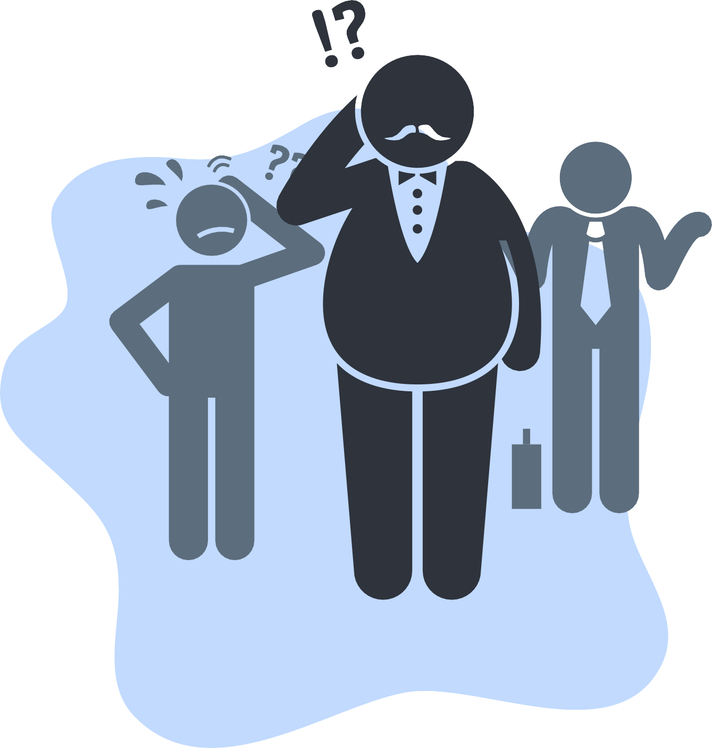
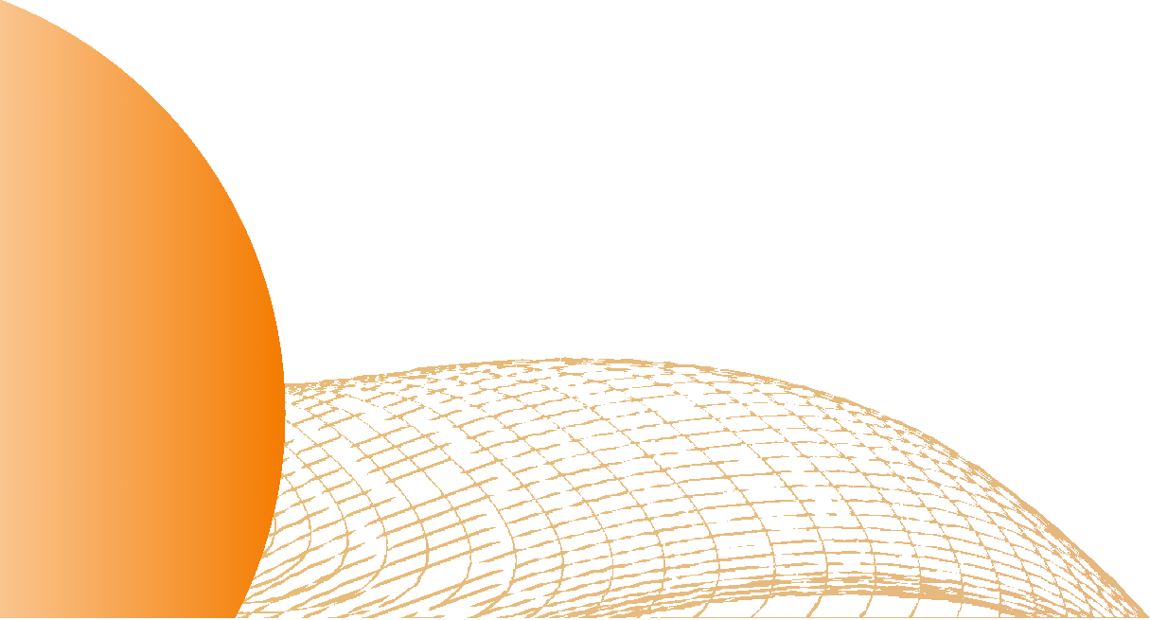
Problem Statement
Passengers do not know at what time a taxi
might show up at their various locations. Taxi locations are unknown resulting in long waits for passengers.
The distress of passengers about the delay of the taxi.
The optimization of fuel consumption.

Slide 12
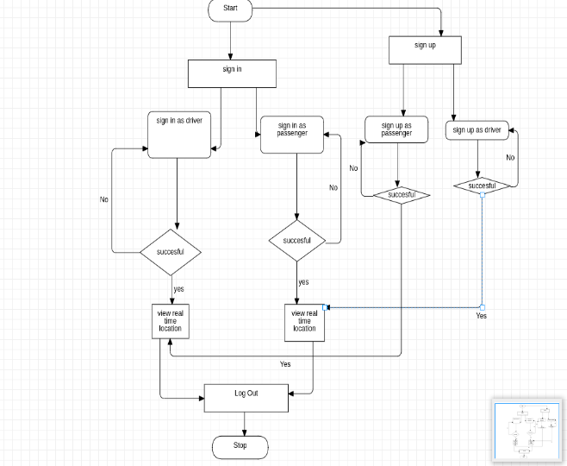

Data flow diagram

Slide 13




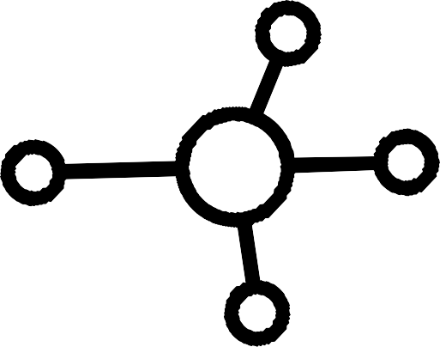

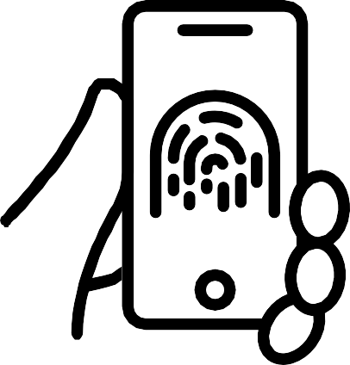

Technical Stack
React Native Bootstrap
HTML
Django or Flask Redis
MYSQL
AWS
Google Maps
Firebase
Front-End
Back-End
Other Technologies

Slide 14
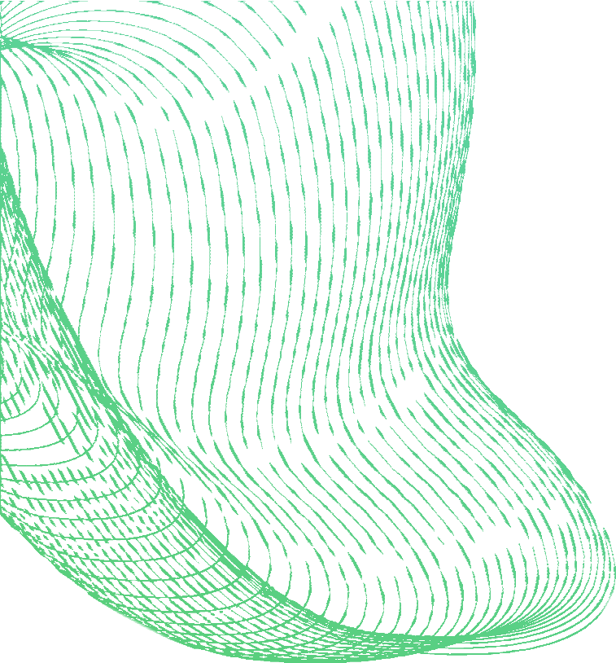



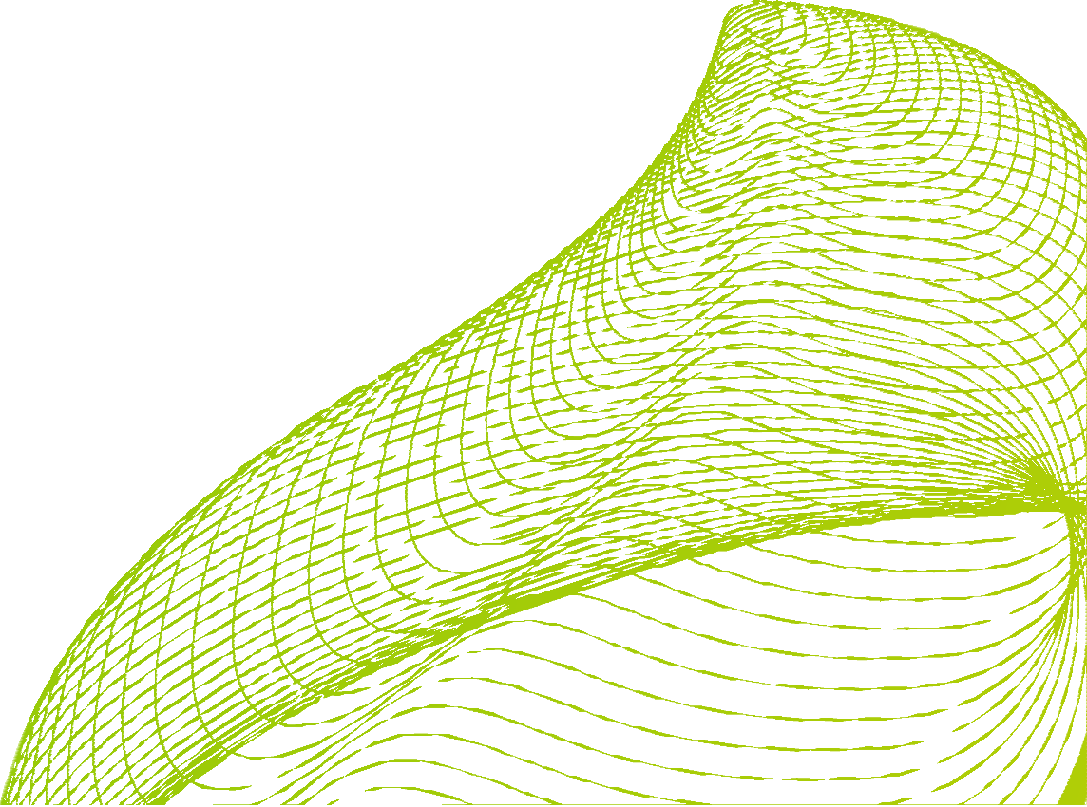


Architecture
Map And Geolocation
Payment
Notification
Cloud Infrastructure

Slide 15
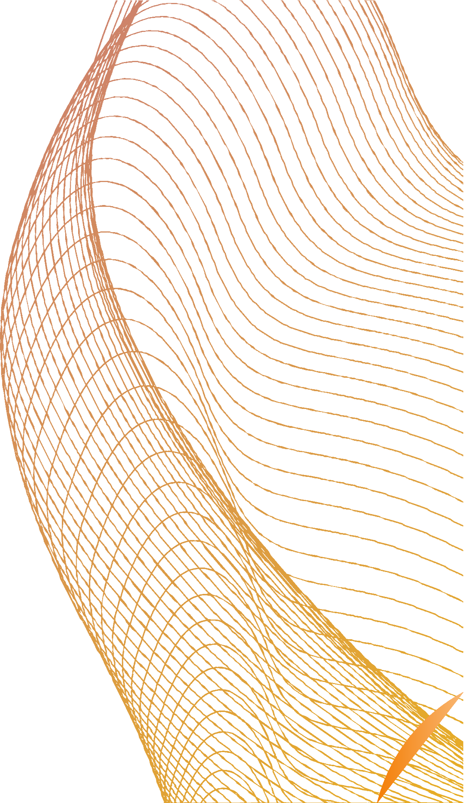

Testing and Quality
Unit testing
Integration testing Continuous testing User acceptance testing Security testing Continuous testing

Slide 16
Thank you

